Slide 1
C# Fundamentals
Paulo R. Flores, MCP, ITIL®
Elinnov Technologies, Inc.
Cyber Security Philippines CERT®

Slide 2
Day 1 Agenda
Introduction to .NET
Basic Concepts
Exploring the Visual Studio Environment
Creating a Simple Windows Console Application Project
C# Language Fundamentals
Types
Statements, Expressions, and Operators
Classes and Structs

Slide 3
Day 1 Agenda (Cont..)
Object-Oriented Programming in C#
Classes and Objects
Abstraction
Encapsulation
Inheritance
Polymorphism

Slide 4
Day 1 Agenda (Cont..)
Programming with C#
Interfaces
Enumeration Types, Arrays and Collections
Strings
Properties
Exception Handling
Delegates and Events
Notes:
Enumeration Types, Arrays and Collections

Slide 5
Introduction to .NET
.NET Languages
.NET Architectural Components

Slide 6
.NET Languages
C#
- simple, powerful, type-safe, and object-oriented
F#
- cross-platform, functional-first programming language
Visual Basic
- an easy language that is closest to ordinary human language

Slide 7
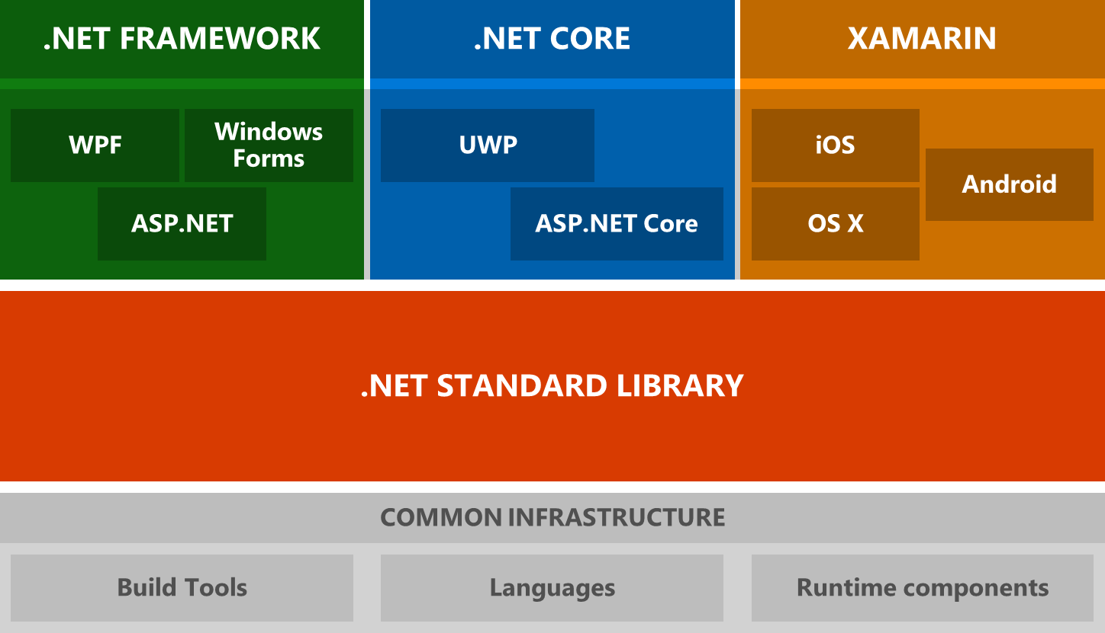
.NET Architectural Components
Notes:
Windows Presentation Foundation
ASP.NET Active Server Pages
is an open-source server-side web application framework designed for web development to produce dynamic web pages.
Universal Windows Platform

Slide 8
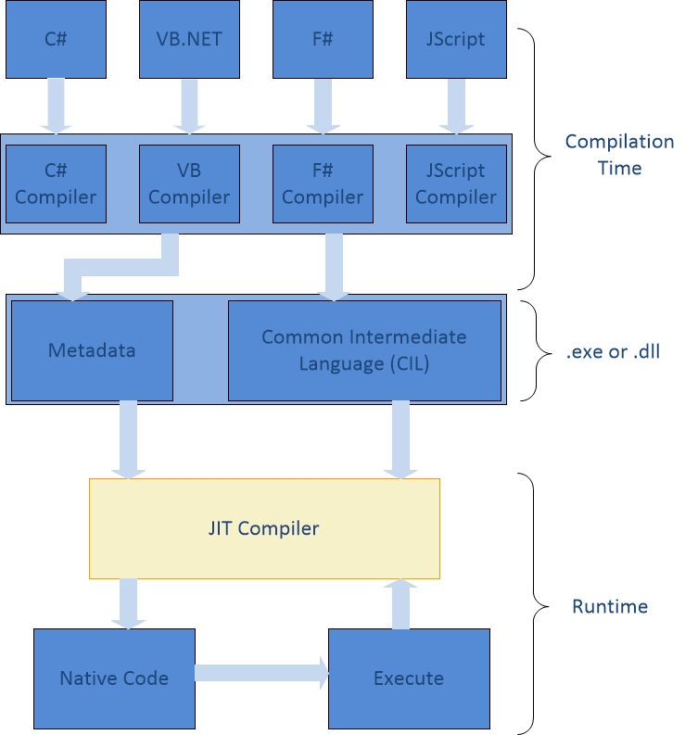
Common Language Runtime Execution Model

Slide 9
.NET Standard Library
a set of APIs which are implemented by a .NET runtime
APIs or Application program interface (API)
is a set of routines, protocols, and tools for building software applications

Slide 10
.NET runtime
Runtime | Year Started | OS Platform | Use | Maintained by
.NET Core | 2014 | Cross-platform (Linux, Windows, Mac OS) | Device, cloud, and embedded/IoT scenarios. | Microsoft and .NET Community – Open Source
.NET Framework | 2002 | Windows | Windows-based apps (Web and Desktop) | Microsoft
Mono for Xamarin | 2004 | Windows, iOS, Android | Mobile apps | Xamarin – Open Source (Mono)

Slide 11
.NET tooling and common infrastructure
The .NET languages and their compilers
Runtime components, such as the JIT and Garbage Collector
.NET project system (sometimes known as "csproj", "vbproj", or "fsproj")
MSBuild, the build engine used to build projects
NuGet, Microsoft's package manager for .NET
The .NET CLI, a cross-platform command-line interface for building .NET projects
Open Source build orchestration tools, such as CAKE and FAKE

Slide 12
Introduction to .NET
Exploring the Visual Studio Environment
Menu bar
Solution Explorer
Properties
Output
Toolbox
Workspace

Slide 13
Creating a Simple Windows Console Application Project
In the Menu bar, click File
Click New > Project
Choose Templates > Visual C# > Windows > Classic Desktop > Console Application
Type a Solution Name and Project Name
Choose the save location
Click OK

Slide 14
C# Language Fundamentals
Types
Statements, Expressions, and Operators
Classes and Structs

Slide 15
Types
Concepts:
Stack vs Heap
Reference vs Value
Boxing and Unboxing
Notes:
Boxing Value to Reference (VRB)
UnBoxing Reference to Value (RVU)

Slide 16
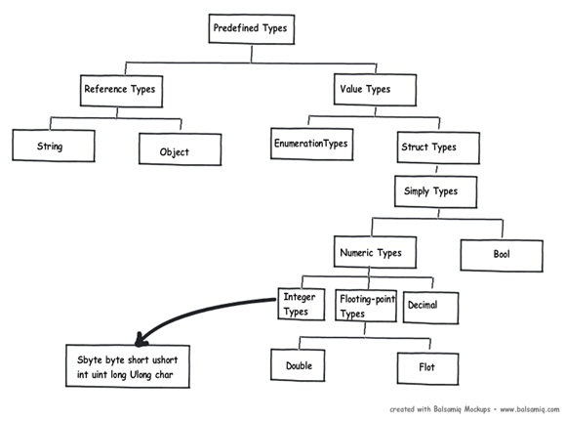
Types

Slide 17
Statements, Expressions, and Operators
DEMO

Slide 18
Classes and Structs
DEMO

Slide 19
Object-Oriented Programming
Classes and Objects, Abstraction, Encapsulation, Inheritance, Polymorphism

Slide 20
Object-Oriented Programming (OOP)
Object-Oriented Programming (OOP)
programming model
objects and data rather than action and logic
decomposition of problem into number of entities called OBJECTS

Slide 21
Classes and Objects
Class – a blueprint, contains data and functions or objects
Object – runtime entities of an object oriented system, data members and functions
Examples:
class Person //class
{
string name = “Paulo”; //a string object
}
Person p = new Person(); //object of class Person

Slide 22
Abstraction vs Encapsulation
Abstraction | Encapsulation
solves the problem at the design level | solves the problem in the implementation level
hides unwanted data and provides relevant data | hiding the code and data into a single unit to protect the data from the outside world
focus on what the object does instead of how it does it | hiding the internal details or mechanics of how an object does something
Outer layout, used in terms of design | Inner layout, used in terms of implementation

Slide 23
Abstraction and Encapsulation
- Implemented using access modifiers (public, private, protected, internal)
- Abstraction works only if the code implementation is encapsulated
Notes:
Encapsulation is a kind of continuation of abstraction

Slide 24
Inheritance
enables you to create a new class that reuses, extends, and modifies the behavior that is defined in another class.
Example:
class DerivedClass:BaseClass{}
class BaseClass{
Object baseObject;
}

Slide 25
Polymorphism
Simply means Many Forms (one interface, multiple functions)
Static Polymorphism or Function Overloading
Dynamic Polymorphism or Method Overriding

Slide 26
Programming with C#
Interfaces, Enumeration Types, Arrays and Collections
Strings, Properties
Exception Handling, Delegates and Events

Slide 27
Interfaces
Interfaces, like classes - define a set of properties, methods, and events.
But unlike classes, interfaces do not provide implementation.
interface ISampleInterface
{
void doSomething();
}
class SampleClass : ISampleInterface
{
void ISampleInterface.doSomething()
{
// Method implementation.
}
}

Slide 28
Enumeration Types
provides an efficient way to define a set of named integral constants that may be assigned to a variable
enum Days { Sunday, Monday, Tuesday, Wednesday, Thursday, Friday, Saturday };
enum Months : byte { Jan, Feb, Mar, Apr, May, Jun, Jul, Aug, Sep, Oct, Nov, Dec };

Slide 29
Arrays and Collections
Arrays - can store multiple variables of the same type in an array data structure
int[10] scores; //type[size] arrayName
int[] scores = new int[] {11, 21}; //type[] arrayName
Collections - provide a more flexible way to work with groups of objects
List<object>
Dictionary<Tkey, Tvalue>

Slide 30
Strings
- object of type String whose value is text
string vs. System.String
string and String are the same; but String has more methods
string name = “Paulo”;
String name = “Paulo”;

Slide 31
Properties
- a member of a class that provides a flexible mechanism to read, write, or compute the value of a private field
public class Date
{
private int month = 7;
public int Month
{
get{ return month;}
set{ month = value;}
}
}
Notes:
public class Date
{
private int month = 7; // Backing store
public int Month
{
get
{
return month;
}
set
{
if ((value > 0) && (value < 13))
{
month = value;
}
}
}
}

Slide 32
Exception Handling
try
{
// Code to try goes here.
}
catch (SomeSpecificException ex)
{
// Code to handle the exception goes here.
}
finally
{
// Code to execute after the try (and possibly catch) blocks
// goes here. (always runs)
}

Slide 33
Delegates
- a type that defines a method signature, and can provide a reference to any method with a compatible signature.
public delegate void SampleDelegate(string str);
class SampleClass
{
// Method that matches the SampleDelegate signature.
public static void sampleMethod(string message)
{
// Add code here.
}
// Method that instantiates the delegate.
void SampleDelegate()
{
SampleDelegate sd = sampleMethod;
sd("Sample string");
}
}

Slide 34
Events
- enable a class or object to notify other classes or objects when something of interest occurs

